Slide 1
Proxy design Pattern in JS
Presented By : Nada Ahmed Aboelkheir

Slide 2
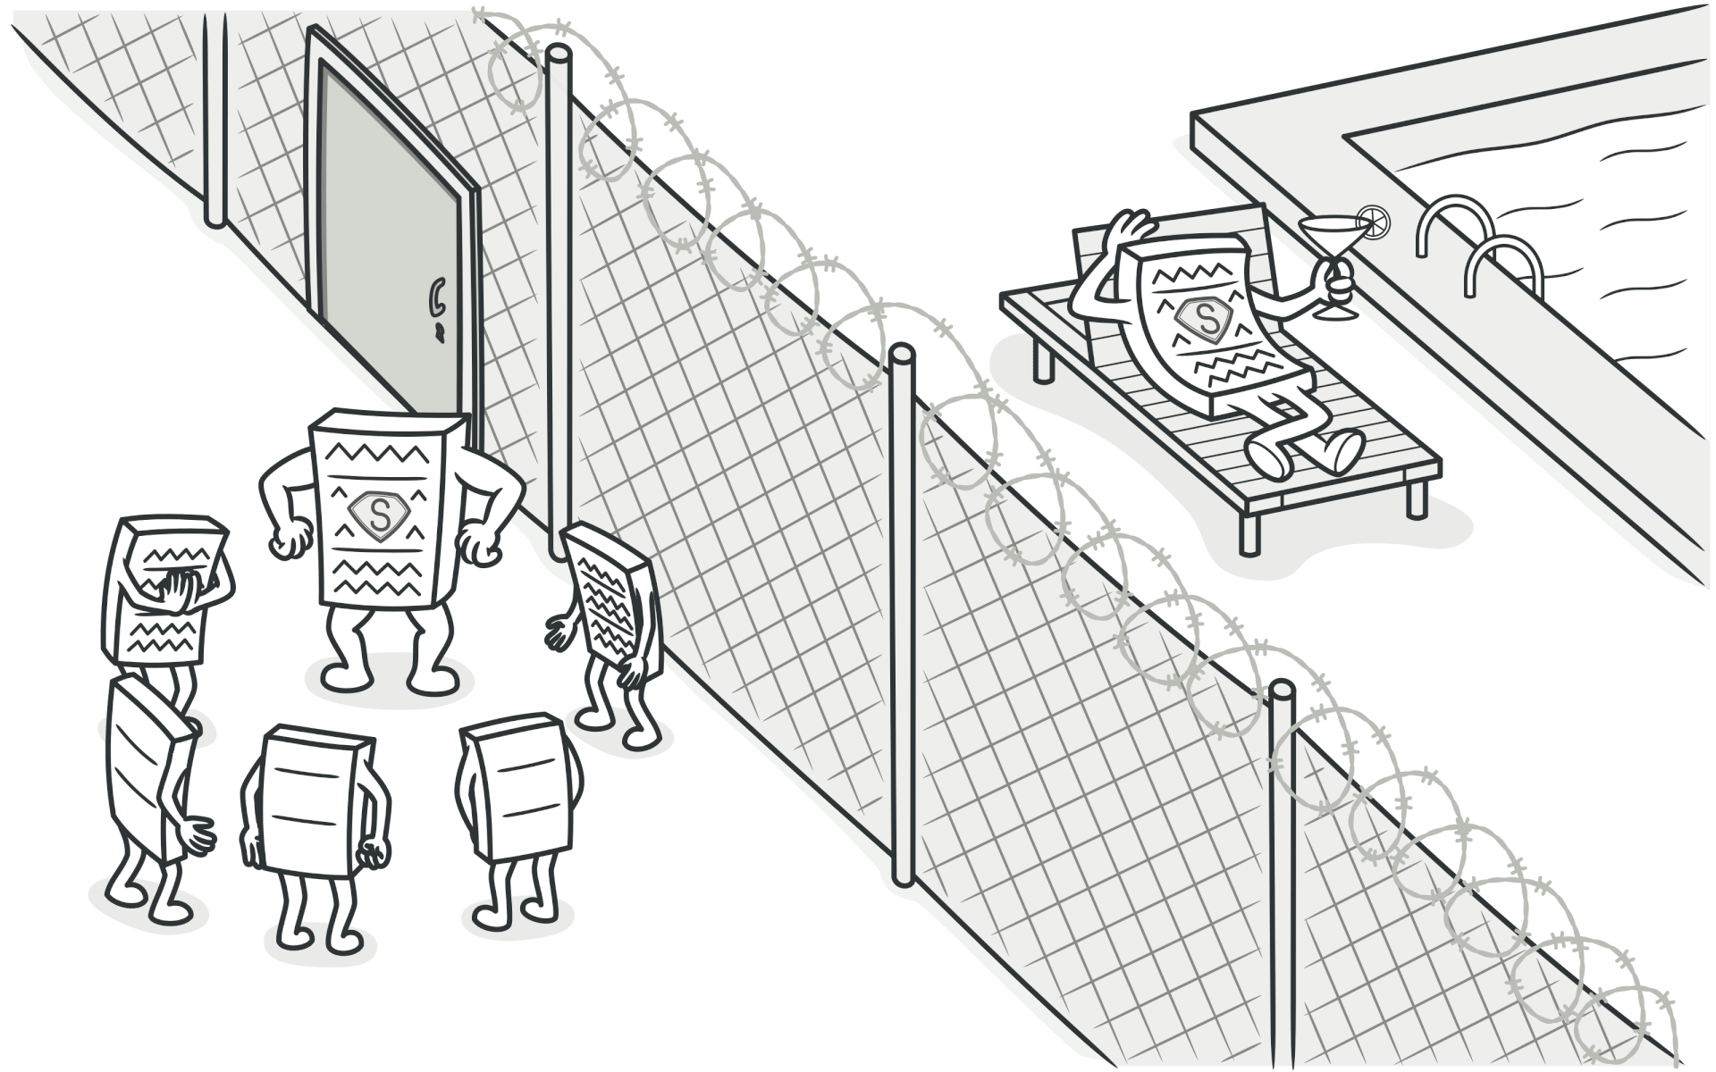
What is proxy ?
Among the other design patterns out there, the Proxy Design Pattern, introduced in 1995 as a Structural Design Pattern, has since found widespread application in various scenarios.
Proxy Method or Proxy Design Pattern also known as Surrogate, it provide a surrogate or placeholder for another object to control access to it.

Slide 3
PROBLEM
Often in object-oriented programming, you might need to control or modify access to an object's methods or properties. This could be for various reasons, such as
01
02
03
Caching
Logging
Remote access
Avoid expensive computations by storing results
Track object interactions for debugging or analysis.
Facilitate communication with a remote object.

Slide 4
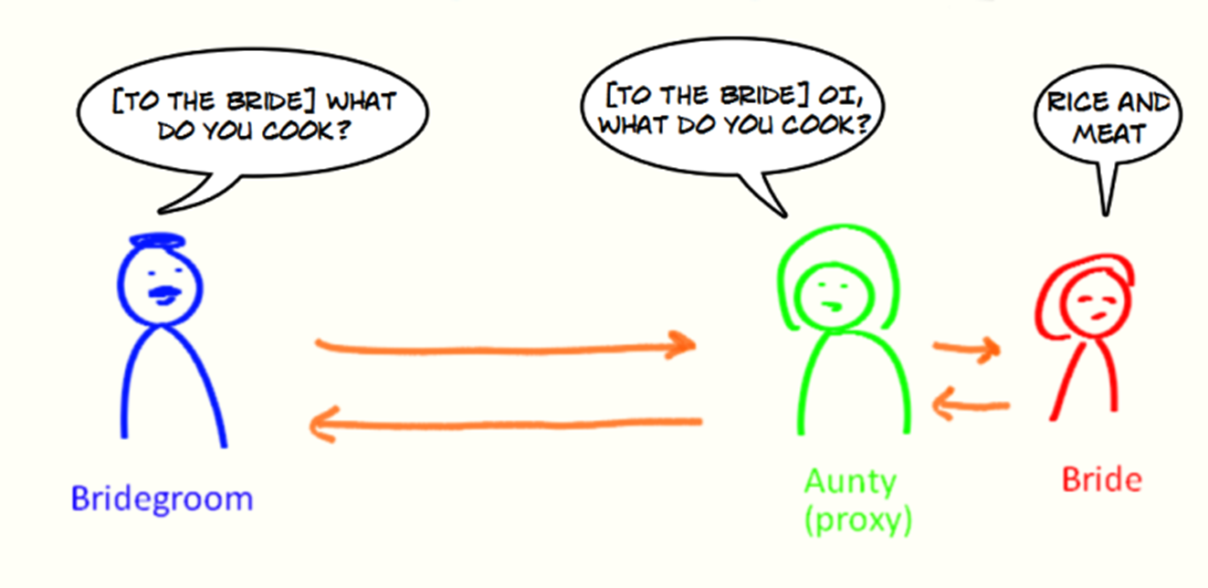
Solution
The Proxy design pattern provides a way to control or modify access to another object (the subject) without directly modifying the subject's code. It introduces a proxy object that acts as an intermediary between the client and the subject. The proxy handles requests from the client and forwards them to the subject, optionally modifying or intercepting the requests or responses..

Slide 5
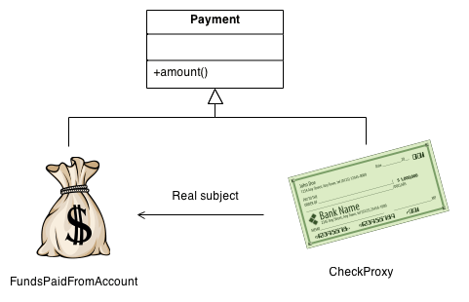
Proxy Components
Proxy: This object is a substitute for the original object that acts as a substitute for the desired object. This object has the same features as the main object, and by using them, commands are transferred to the main object.
Target: This object is the main object that the proxy modifies.
Client: This is the object that interacts with the proxy to access the desired object.

Slide 6
Benefit of proxy
By implementing a proxy object, you can execute some other logic before or after executing the main logic of the class.
01
02
03
04
Improving security
Reduced Resource Consumption
Network Optimization
Concurrency Control

Slide 7
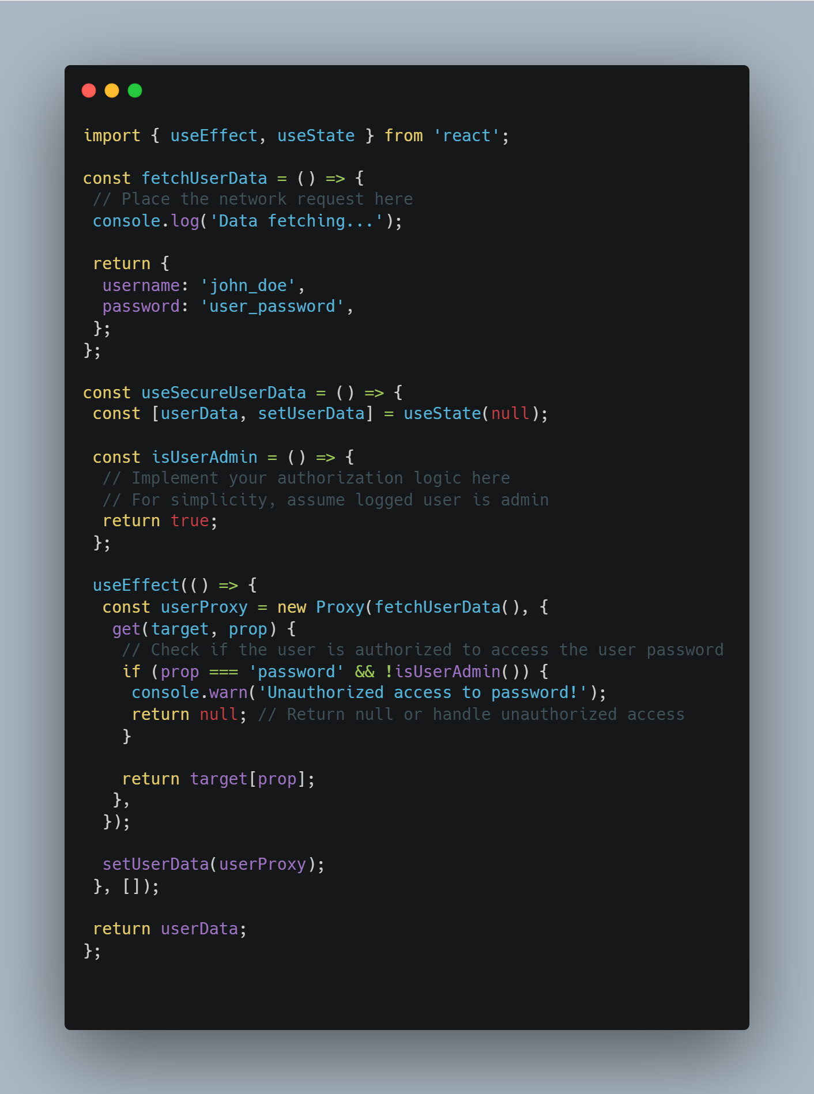
Proxy in React
Proxy design pattern can enhance security in a React application by controlling object interactions and sensitive data access. It provides a basic example and emphasizes that alternative approaches such as Higher-Order Components (HOC), the Context API, and router guards are often used for access control in React. The choice of method depends on the application's specific requirements.

Slide 8
Resources
https://www.geeksforgeeks.org/structural-design-patterns/?ref=shm#proxy-method-design-patterns
https://blog.bitsrc.io/proxy-design-pattern-with-react-c0b465980fbf

Slide 9
THANK YOU

